Slide 1

NE-533 Nuclear Fuel Performance
Review on:
Ceramic Nuclear Fuel Fracture Modeling with the Extended Finite Element Method
Mahmoud Hawary

Slide 2
Outline
Introduction
Governing Equations
Phantom-node-based X-FEM
MOOSE/BISON X-FEM Implementation
X-FEM Crack Initiation and Propagation
Numerical Examples:
Rectangular plate with an inclined crack
Crack propagation in a cruciform plate
LWR fuel pellet cracking
Critique and What next?
Conclusions

Slide 3
Introduction
Thermal gradients generate non-uniform volumetric expansion which causes tensile stresses high enough to result in fracture.
Under normal operating condition, thermal stresses cause the formation of radial and axial cracks.
Cracks formation leads to the following:
Decrease the constraint in the region of formation which increases the average pellet diameter.
Radial relocation where the fragments move radially outward which decreases the fuel gap
Decrease the effective conductivity in directions normal to the gap
PCMI due to the stress concentrations in the cladding adjacent to cracks
Many models have been used in fracture modelling within the context of the FEM:
Smeared cracking model
Cohesive zone model
Discrete element method (DEM)
The eXtended Finite Element (X-FEM):
Allows for arbitrary spatial discontinuities to be represented withing the context of the FEM.
Allows for discrete cracks to traverse a domain discretized with a FE mesh without explicitly fitting the mesh to the crack geometry.
It enriches the FE approximation and adds extra degrees of freedom to the discontinuities.

Slide 4
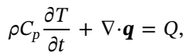
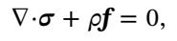
Governing Equations
The physical behavior of the stationary and propagating fractures coupled with thermo-mechanics problem is governed by fully-coupled partial differential equations for energy and momentum conservation.
The constitutive behavior considered is the elastic behavior only.
Assumptions made:
Fracture introduces discontinuities in both temperature and displacement.
No heat flux across the fracture.
The fracture surfaces are traction-free.

Slide 5
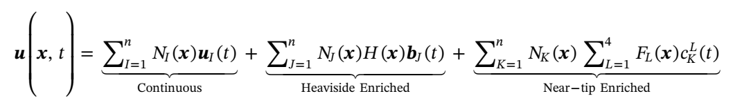
Phantom-Node-Based X-FEM
X-FEM enriches the standard FE interpolation of the solution field with Heavside and near-tip enrichment functions:
Phantom node method is used to model mesh-independent fracture.
In Phantom node method elements intersected by a crack are deleted and replaced by two elements that occupy the same physical locations as the original elements.
Phantom nodes are the nodes connected to the non-physical portion of the elements.
Solution field is interpolated on the partial elements using the standard FE functions.
It was shown that Phantom node technique gives exactly the same enrichment as the originally proposed X-FEM and added the same number of the extra degree of freedom to the system.
In this work, the near-tip enrichment has not been included in the phantom method.

Slide 6
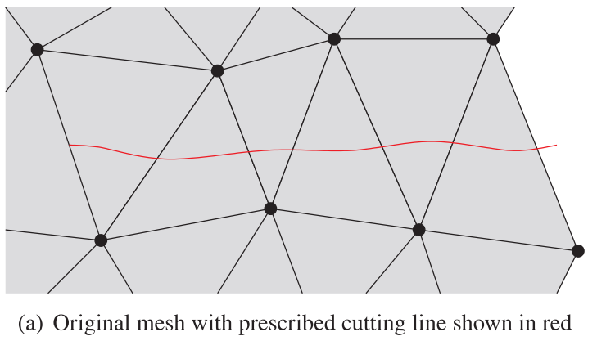
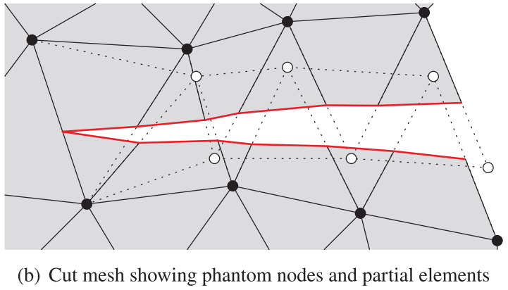
Mesh Cutting Algorithm
Neighboring elements that share a common cracked edge should share physical and phantom nodes to ensure the continuity of FE solution field.
Elements on opposing sides of a crack should have no connectivity to ensure the discontinuity.
The cutting algorithm used in this work is called “Element Fragment Algorithm” (EFA).
If only Heaviside enrichment is used, crack tips should coincide with FE boundaries.
To properly represent the topology at crack tips, the cut edges of the partial elements representing the material on opposing sides of the crack must be merged with the uncut element ahead of the crack tip.
Simulation of crack propagation adds additional complexity to the cutting algorithm.

Slide 7
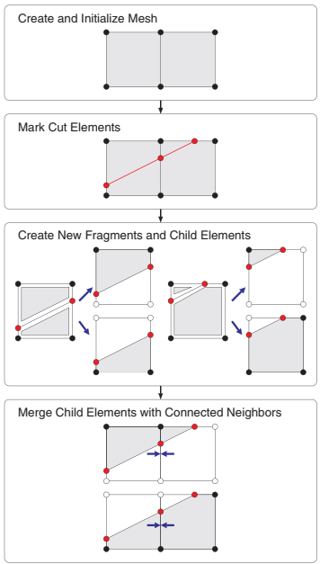
Element Fragment Algorithm
This algorithm is designed to be called repeatedly during the analysis so the crack topology could be evolved.
Each time the mesh is to be modified; the following steps are followed:
Create and initialize mesh.
Mark cut elements
Create new fragments and child elements
Merge child elements with connected neighbors.
When this algorithm is completed:
all temporary nodes should be deleted and replaced by permanent nodes.
a set of new child nodes and a set of new child elements to be created, as well as a set of parent elements to be deleted.
the new child elements and nodes are all associated with their parents.
material data can be transferred to the child elements and nodal solution data can be transferred to the child nodes

Slide 8
MOOSE/Bison X-FEM Implementation
Bison is built on the open-source MOOSE multiphysics framework.
MOOSE provides it the flexibility to include arbitrary coupled systems of partial differential equations (PDEs) describing the relevant physics models in a multidimensional setting.
In MOOSE framework, new physics models could be added such as additional terms in a PDE, material models, or additional field variables.
Phantom-node-based X-FEM approach can be applied generically to include discontinuities in a variety of systems of PDEs solved using the finite element method.

Slide 9
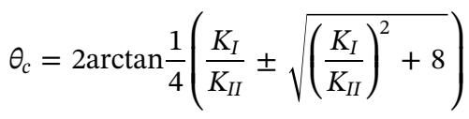
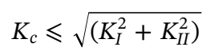
X-FEM Crack Initiation and Propagation
X-FEM enriches the solution given the locations of the discontinuities, but it does not by itself define the locations of those discontinuities.
The maximum hoop stress criterion is used to determine the direction of the crack propagation.
The asymptotic near-tip hoop stress is given by:
The critical direction is given by:
The stress intensity factors could be computed using domain forms of the interaction integrals.
The condition of the crack propagation after nucleation is determined by the failure criterion given by:
The crack will continue to propagate until this criterion is no more met.

Slide 10
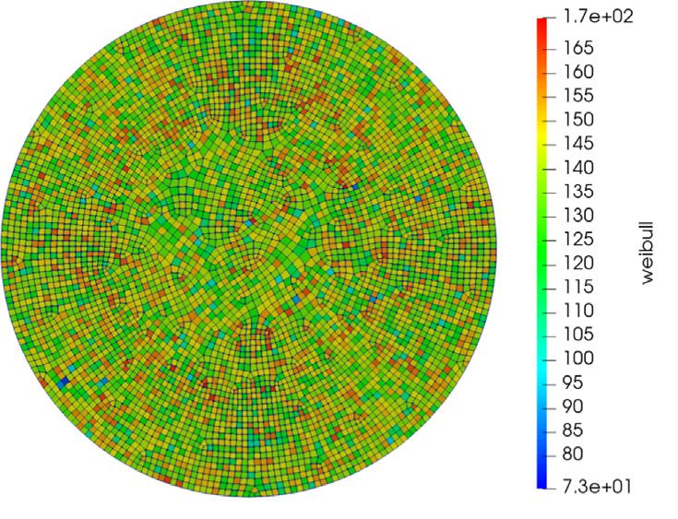
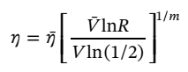
X-FEM Crack Initiation and Propagation
Stresses are the highest on the outside surface of a fuel pellet due to the nonuniform thermal expansion.
In this work, cracks are permitted to initiate only on the outer surface of the fuel.
The max hoop stress criterion is checked for the elements adjacent to the exterior boundary.
If the criterion is met in a given element, a crack is initiated by cutting through the element in the direction normal to the hoop stress.
Cracks would simultaneously initiate at every element around the pellet exterior once the critical hoop stress criterion is met.
In this work, a random distribution of local fracture strength is introduced to limit the number of cracks initiated.
A volume-corrected Weibull distribution is used:

Slide 11
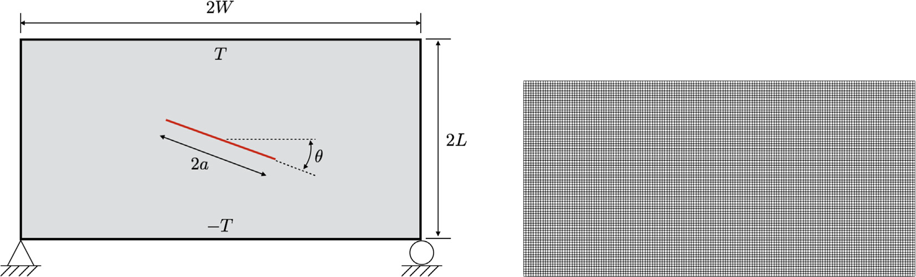
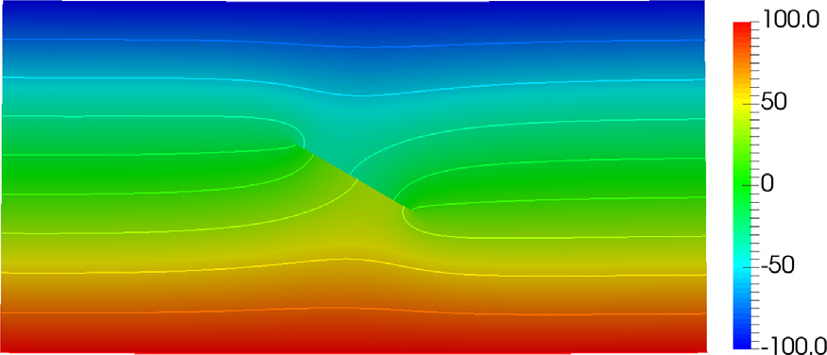
Rectangular Plate with an Inclined Crack
This case has been considered to benchmark the X-FEM approach.
Rectangular plate under plane strain conditions containing an inclined crack and subjected to a temperature gradient.
Two sets of the parameter studies were performed
Fixed crack angle and vary the crack length.
Fix the crack length and vary the crack inclination.
The computed SIFs showed a good agreement with the reported for the same problem.

Slide 12
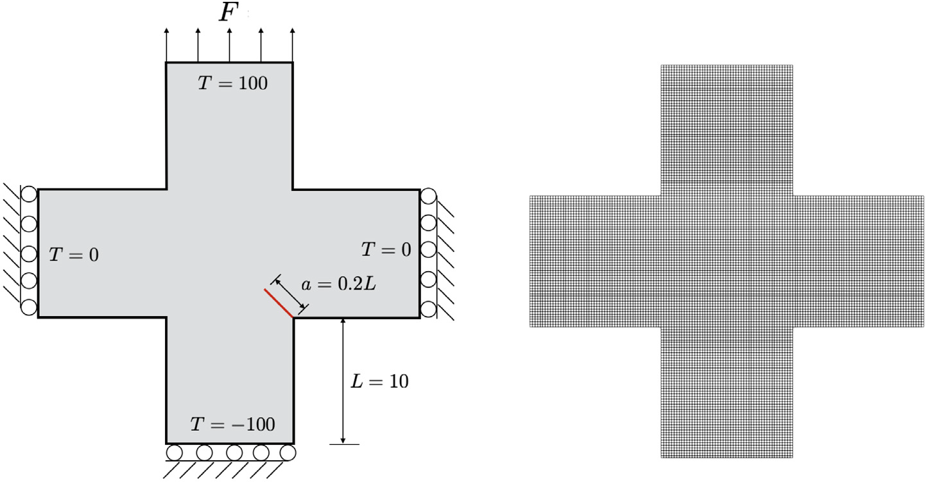
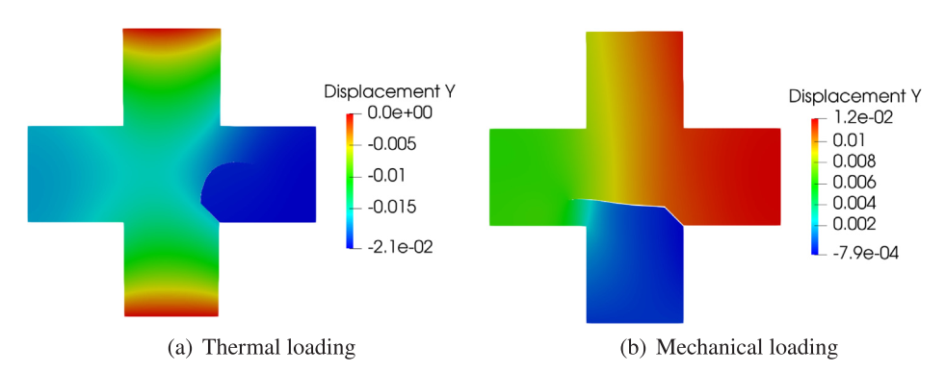
Crack Propagation in a Cruciform Plate
The example has been considered to demonstrate the ability of the thermo-mechanical X-FEM to represent crack propagation.
A pre-defined crack placed at one of the re-entrant corners.
Two different cases with different boundary conditions are considered.
Driven primarily by thermal loading
Only mechanical loading and no temperature gradient.

Slide 13
LWR Fuel Pellet Cracking
To demonstrate the use of the X-FEM to model LWR fuel pellet cracking:
a 2D generalized plane strain model of a fuel pellet has considered
problem is designed to represent the conditions in fresh fuel subject to a ramp to full power
only the fuel pellet is considered without cladding
a full Bison simulation including both fuel and cladding was run through the power ramp, and the time history of fuel outer temperature was applied as a boundary condition
Spatially uniform volumetric heating is applied
Time-dependent effects have been minimized by having a slow ramp rate.

Slide 14
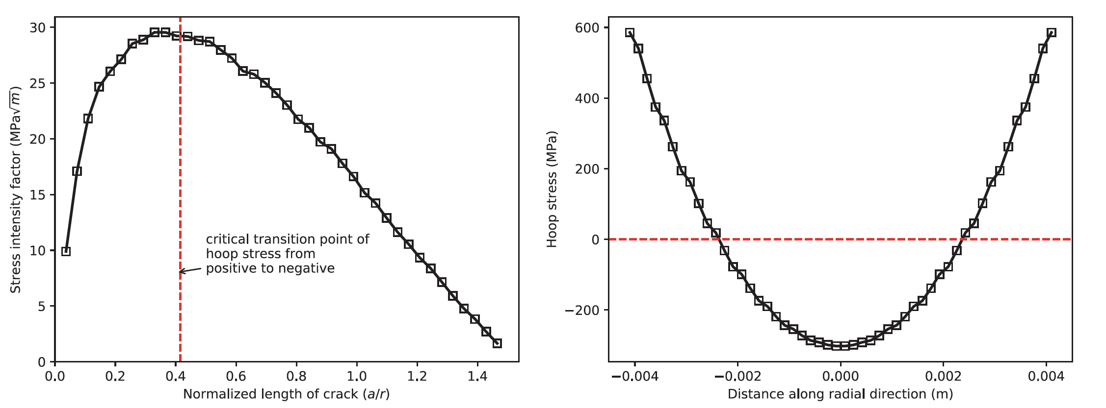
Stationary Cracks in an LWR Fuel Pellet
The stress field in the vicinity of a given crack is influenced by the presence of other cracks.
Interactions between cracks will determine whether a power ramp will result in propagation of existing cracks or nucleation of new cracks.
To investigate that, stationary cracks of varying number and length have been studied and the SIFs have been obtained:
Single crack with varying length
Fixed crack length with varying number
Both crack length and number are varied
At the beginning, the SIF increase as we increase the crack length.
The SIF reached a maximum value which beyond, it will decrease as the crack length increases.
The maximum point is corresponding to a transition point from tensile to compressive stresses caused by thermal stresses.

Slide 15
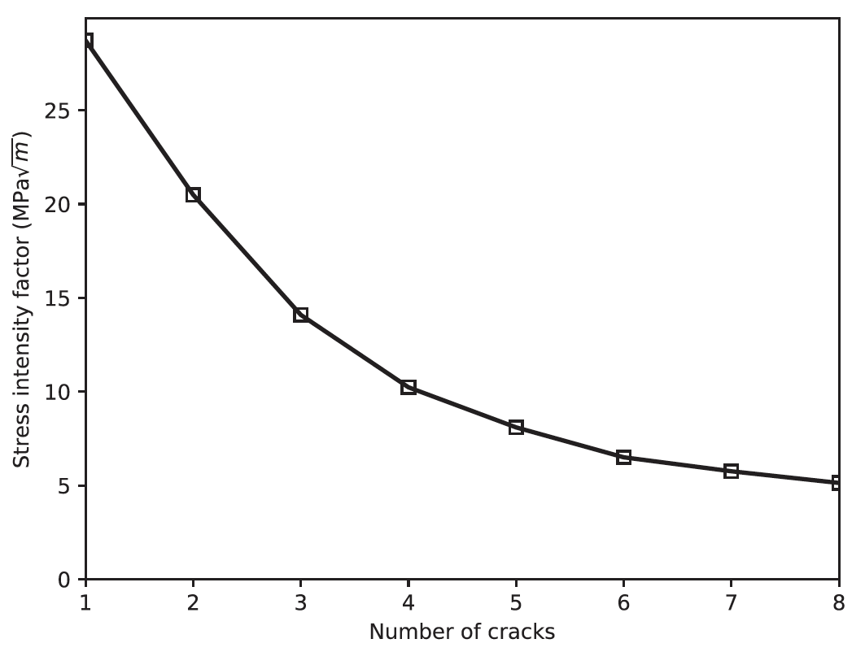
Stationary Cracks in an LWR Fuel Pellet
For cracks with the same length, as their number increase, the SIF decreases.
The presence of other cracks decreases the constraint on the outside of the pellet and reduces the average hoop stress at a given radius, which reduces the SIF at the crack tips.
The decrease of the SIFs with the number of cracks follows an exponential function.
Beyond 5 or 6 cracks, no significant decrease occurs with increasing the cracks number.

Slide 16
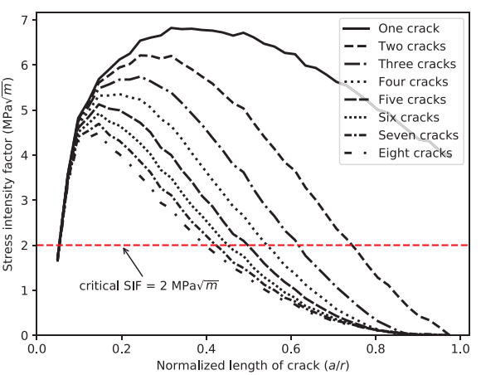
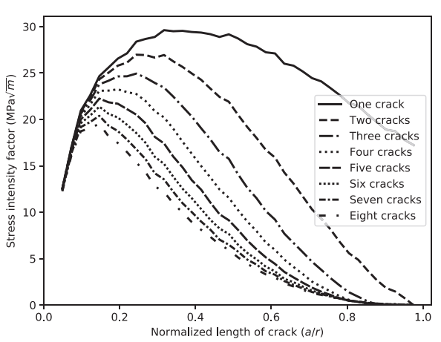
Stationary Cracks in an LWR Fuel Pellet
These two plots show the stress intensity factor as a function of crack length for varying numbers of radial cracks from one to six together on a single plot at two different points in time during the same ramp to full power.
At higher powers, the family of curves has essentially the same shape, but is scaled up.
The power level in the upper plot is smaller than the level at the cracks are expected to initiate.
Thermal stresses cause the stress intensity to exceed the material’s toughness.
Initiating additional cracks or propagating existing cracks can reduce the SIF until a stable equilibrium state is reached.
The final number of cracks at a given power level depends heavily on the number of the large cracks that initiated with intensity factors above a critical value.

Slide 17
Propagating Cracks in an LWR Fuel Pellet
To predict the propagation of discrete cracks in a nuclear fuel pellet:
no initial cracks are prescribed
cracks are permitted to initiate in elements adjacent to the exterior boundary
Crack will initiate if maximum principal tensile stress exceeds the tensile strength of the material
Once the cracks initiate, fracture integrals are evaluated.
cracks are allowed to grow if the stress intensity factor exceeds a critical value.
Two separate simulations were run, using critical stress intensity factors.
Typical values for ceramics are considered.
There is no enough experimental data available to validate these models.
Fracture propagation in LWR fuel is relatively insensitive to the fracture growth criteria.
A simple sensitivity study is considered in this work.

Slide 18
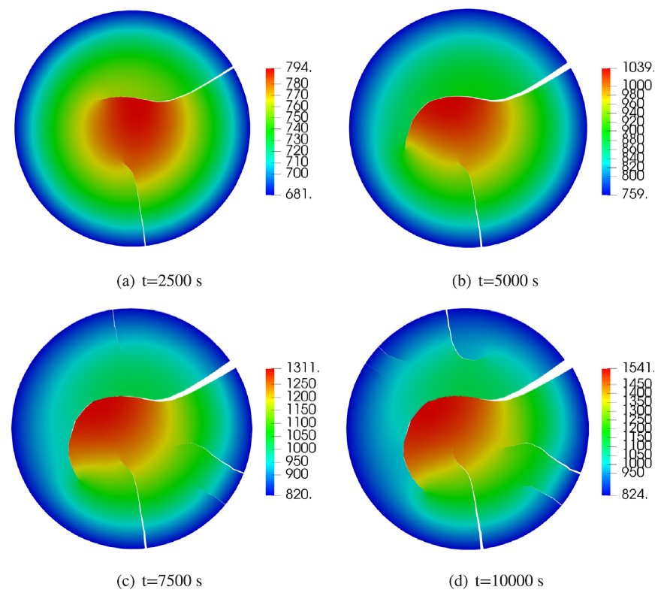
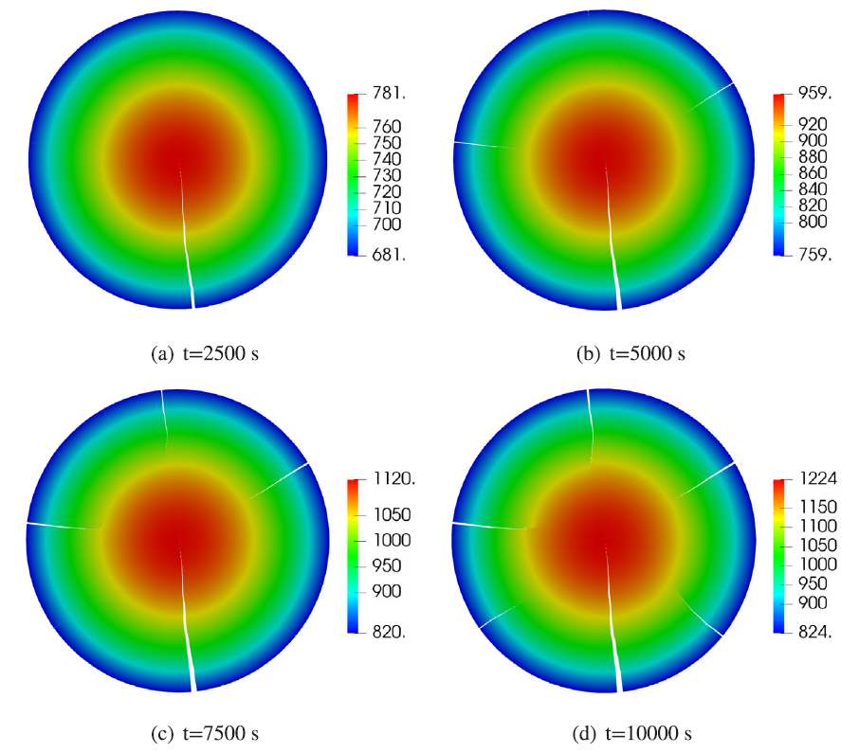
Propagating Cracks in an LWR Fuel Pellet
Low SIF
High SIF

Slide 19
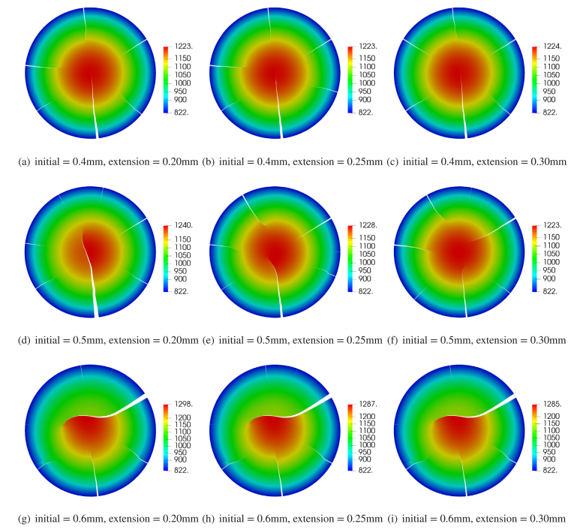
Propagating Cracks in an LWR Fuel Pellet

Slide 20
Critique
Many typos were found.
It was not clear why the near-tip enrichment has been neglected and whether it can be used with the phantom-node-based method or not.
At the beginning, authors stated that the aim to demonstrate the implementation of X-FEM in Bison, however, in section 4 they discussed the implementation in MOOSE. Are they same or different?
The calculation method of the SIF are not clear.
Why the defects have been distributed over the whole pellet even though the cracks are assumed to initiate at the exterior only?
There’s a mismatch between figure 9 and figure 8.
What next?
Reconsider the assumption that have been made.
Perform a comprehensive sensitivity analysis.
Combine and integrate this model with physical models.
Try to simulate a fuel pellet with real manufacturing defects.

Slide 21
Conclusion
This work was aiming to develop a usable engineering capability for modeling fracture propagation in ceramic nuclear fuel.
Thermo-mechanical phantom node-based X-FEM was used to study the fracture of different benchmark problems.
Benchmarking results agree well with the results reported in the literature.
X-FEM is suitable to be implemented in the BISON code because it has the same advantages as the standard FE besides the ability to simulate the fracture.

Slide 22
Any Questions!

